Slide 1

Introduction to AMAZON WEB SERVICES

Slide 2
agenda
What is AWS?
Global Infrastructure
Regions
Availability Zones
Edge Location Free Tier
What is EC2?
EC2 use cases
EC2 instance types
Launching instance
What is S3?
Bucket
Objects
S3 UI
Use cases
What is IAM?
IAM users
Roles
Policies
Permissions

Slide 3
What is aws?
It is a Cloud Computing Platform by Amazon
It was launched in 2006, now it is the most used cloud service provider.
It offers 200+ services like Compute, Storage, Database etc
It is used by companies like Netflix, NASA, Airbnb and more
It Allows “pay-as-you-go” billing — no need to buy hardware

Slide 4
Benefits of using aws
Cost Saving : No need to buy costly physical servers
Scalability : Easily handles sudden traffic spikes
Global reach : Users can access services from anywhere with low latency
Reliability : Servers run even if one data centre fails.
Security : Encryption , IAM, MFA.

Slide 5
AWS GLOBAL INFRASTUCTURE
AWS Global Infrastructure is the physical foundation behind all AWS services. It includes Regions, Availability Zones, Edge Locations, and Local Zones. These are spread across the world to help deliver AWS services with high speed, better reliability, and low downtime. It’s designed in such a way that even if one part fails, others can still keep running smoothly

Slide 6
AWS REGIONS
A Region is a specific location in the world where AWS has its data centers.
Each Region includes multiple data centers, which are called Availability Zones
Regions are completely separate from each other to avoid failures spreading.
We can choose a Region that is closest to our users for better performance.

Slide 7
Availability zones(az)
An Availability Zone is a separate data centre inside a Region.
Each Region has 2 or more AZs (for backup and high availability).
AZs are physically separated, but they are connected with fast networks.
If one AZ has a problem, the others can still keep the service running
Example AZs in Mumbai region- ap-south-1a,ap-south-1b,ap-south-1c

Slide 8
EDGE LOCATION
An Edge Location is a mini data center that is placed close to users.
It is used by Amazon CloudFront (AWS’s CDN service).
It stores cached data like images, videos, HTML files near users for faster loading
Helps reduce latency (delay) and improves speed.
There are 400+ Edge Locations around the world.

Slide 9
AWS FREE TIER
Free Tier valid for 12 months for new users
Includes 750 hours/month EC2 usage
5 GB S3 storage, 750 hours RDS usage
Also includes Lambda, CloudFront etc.
Explore services without charges

Slide 10
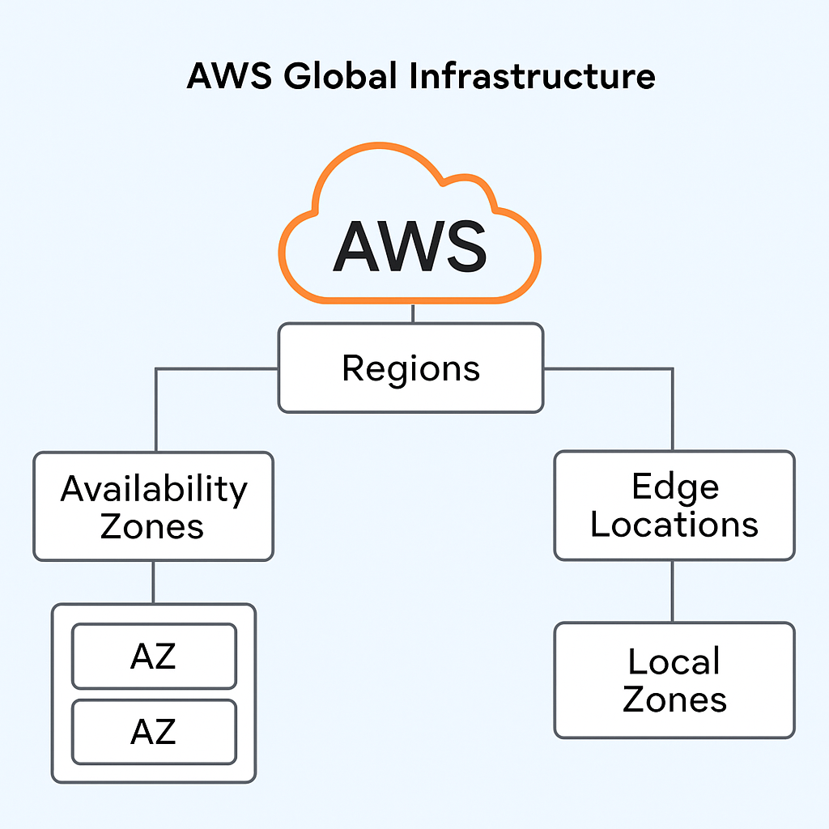
ARCHITECTURE

Slide 11

Amazon ec2(elastic compute cloud)
What is EC2?
It is a cloud b based Virtual server that allows to run application without having to buy and maintain physical servers.
Quickly launch , configure and scale servers
Uses pay-as-you-go model
It integrates with other AWS services for storage , scaling and traffic handling.
Provides control over the operating system

Slide 12
EC2 use cases
Web hosting: Host websites and web apps without on premise hardware.
Application hosting: Run backend services , APIs or enterprise applications.
Data procession: Big data analytics , machine learning, model training
Disaster recovery: Keep backup servers ready in other locations.
Development and testing: Quickly spin up test environment and delete when done.
Batch processing: Automating large number of jobs.

Slide 13
Aws instance types
Type | Description | Example Use Case
General Purpose(t3,m6g) | Balanced compute, memory, storage | Web servers, dev environments
Compute Optimized(c7g,c6i) | High-performance processors | Gaming, ML inference
Memory Optimized(r6g,x2idn) | Large memory size | In-memory databases
Storage Optimized(i4i,d3en) | High storage throughput | Big data, analytics
Accelerated Computing(p4,g5) | GPU/FPGA support | AI/ML training, video processing

Slide 14
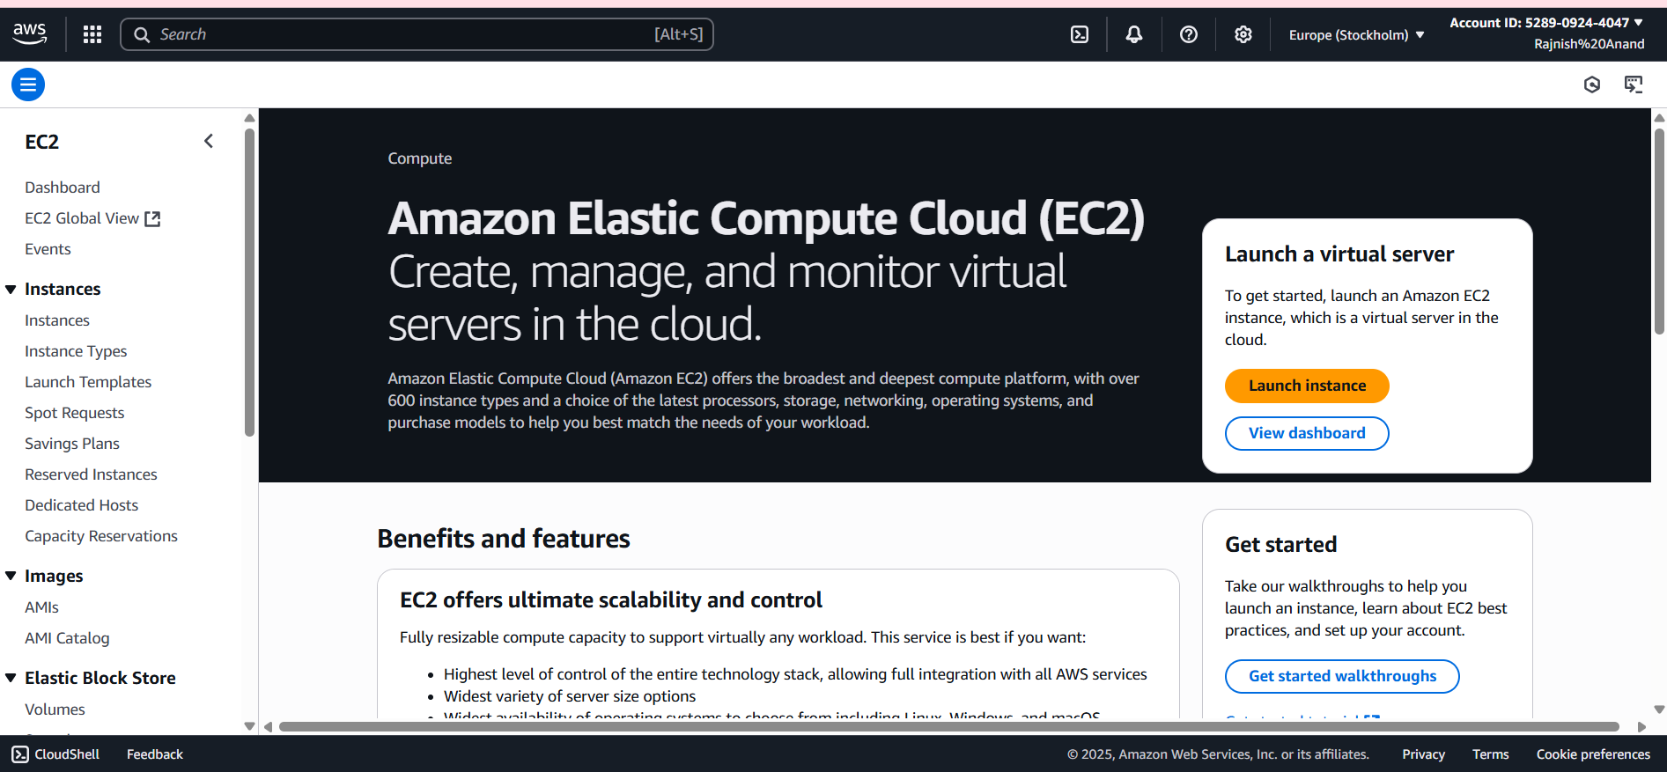
Launching an instance

Slide 15
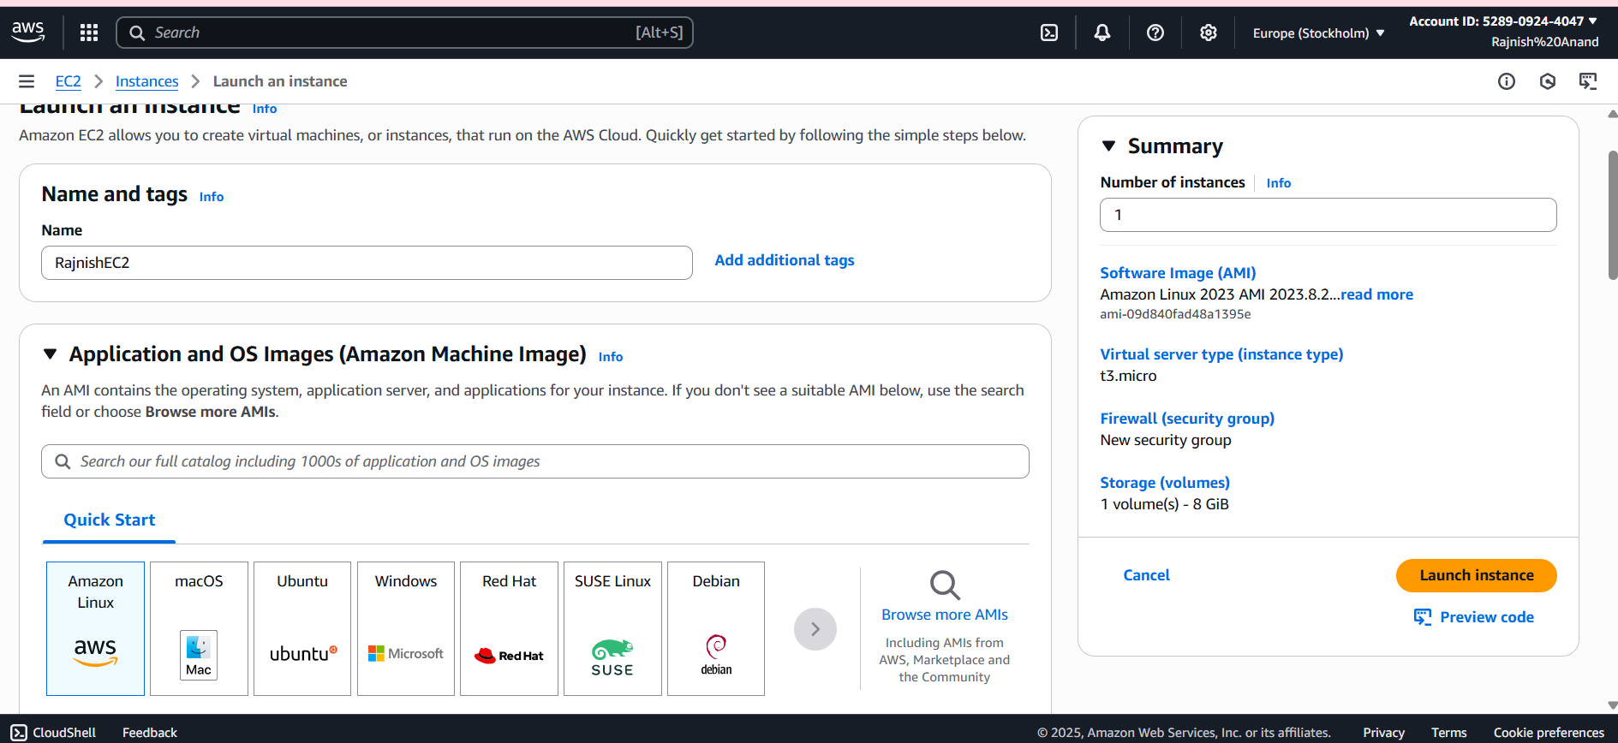

Slide 16
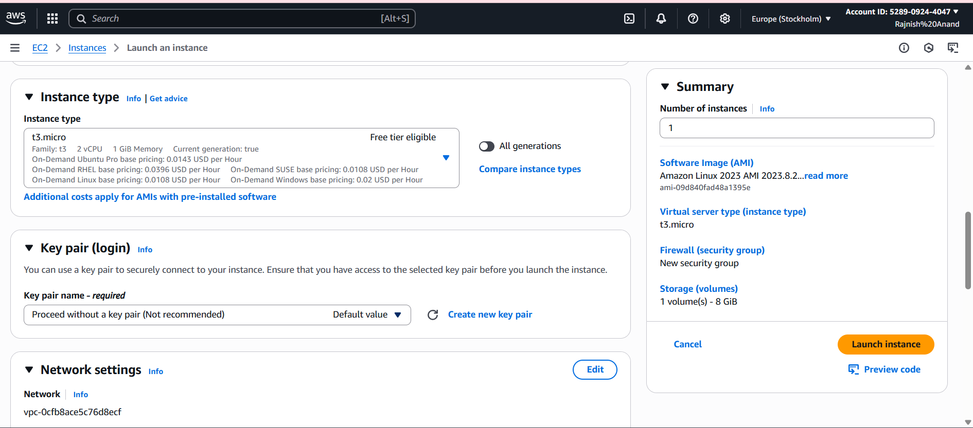

Slide 17
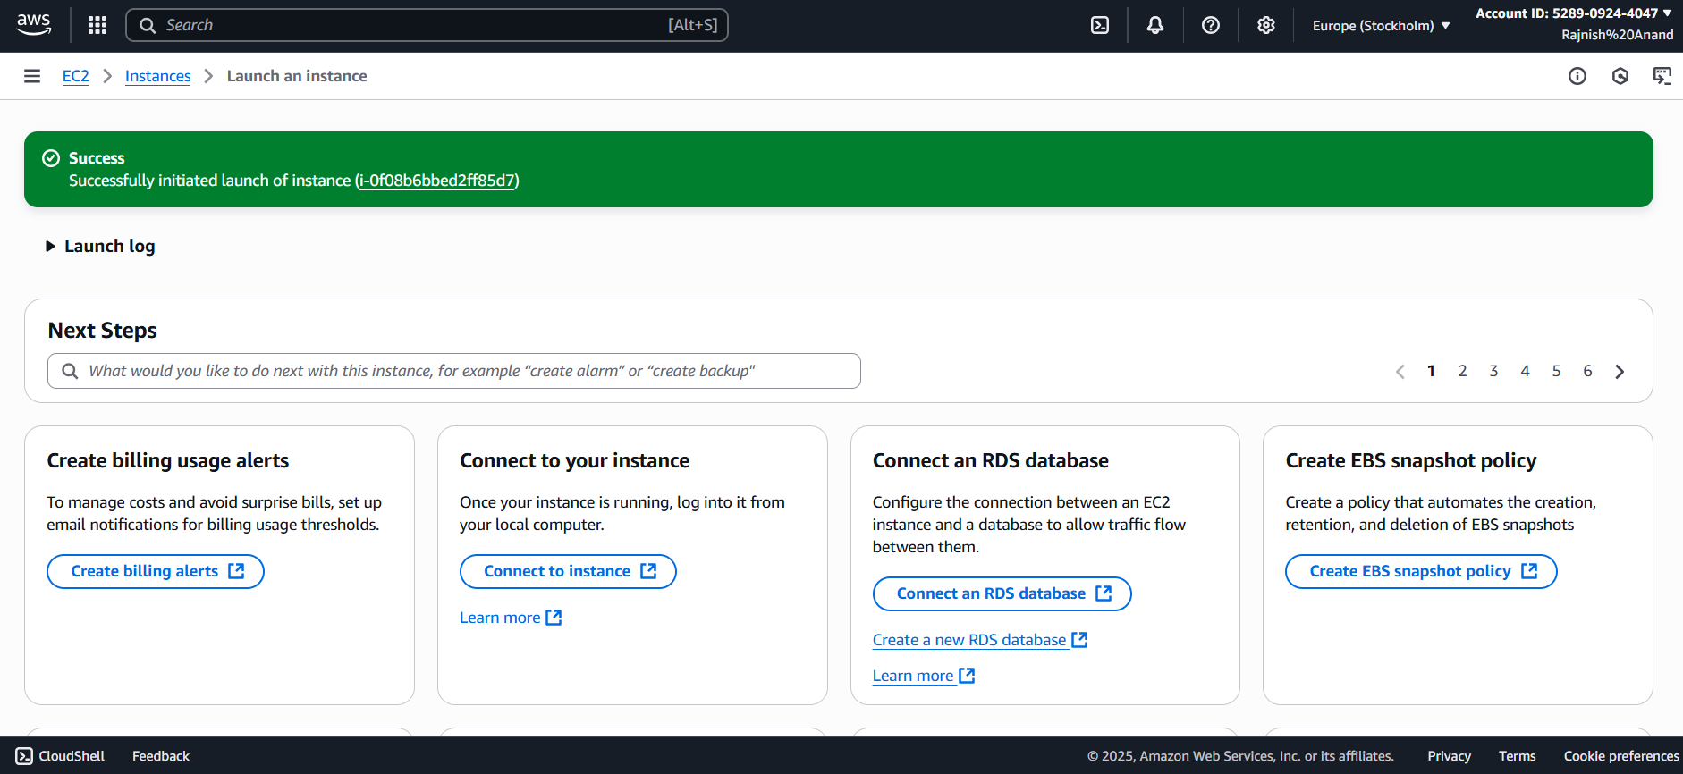

Slide 18
Amazon s3(SIMPLE STORAGE SERVICE
What is S3?
Amazon S3 is an object storage service that offers industry-leading scalability, data availability, security, and performance.
It stores data as object inside buckets.
Each object contains:
Data (your file)
Metadata (information about the file)
Unique key (identifier)

Slide 19
Buckets
Buckets are the container for objects.
For each bucket, you can control access to it (who can create, delete, and list objects in the bucket)
You can view access logs for it and its objects, and choose the geographical region where Amazon S3 will store the bucket and its contents.

Slide 20
OBJECTS
Objects are the fundamental entities stored in Amazon S3
Objects consist of object data and metadata
Every object is contained in a bucket
The metadata is a set of name-value pairs that describe the object
Files + metadata stored in buckets.
An object is uniquely identified within a bucket by a key (name) and a version ID (if S3 Versioning is enabled on the bucket)

Slide 21
USE cases
Data backups & archiving.
Hosting static websites.
Storing big data for analytics.
Media storage (images, videos, documents).
Disaster recovery & replication.

Slide 22
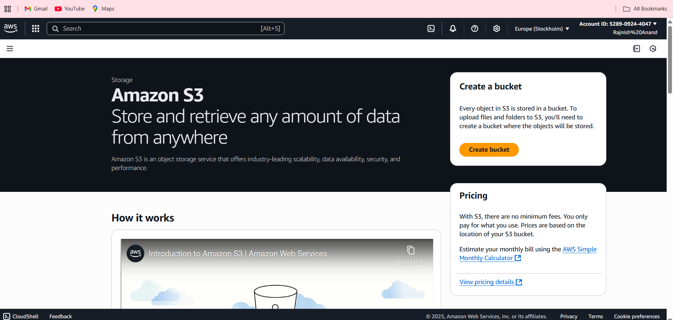
S3 UI

Slide 23
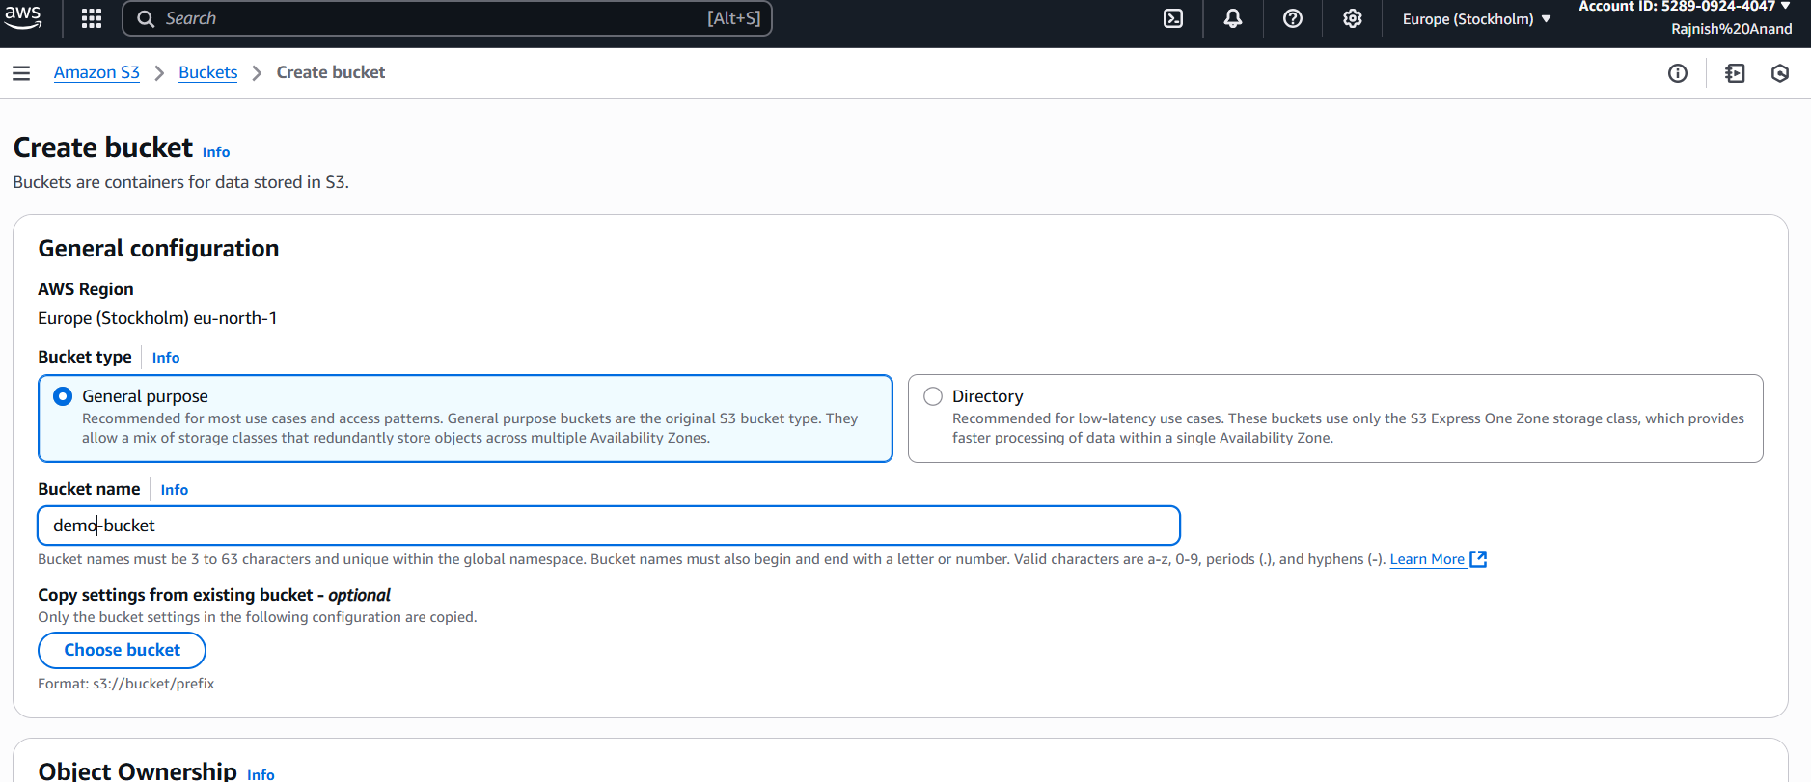

Slide 24
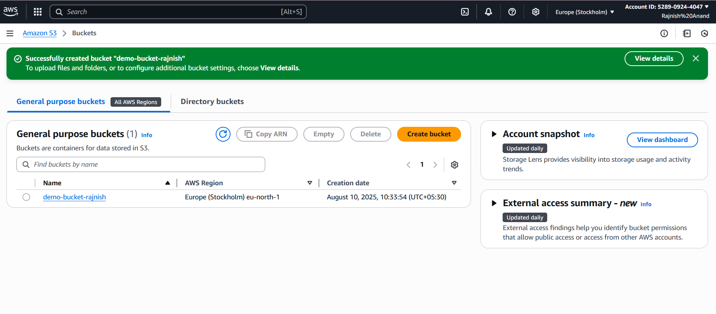

Slide 25
IAM(IDEnTITY ACCESS MANAGEMENT)
Identity and access management is the security service that securely manages AWS resources.
It enables the right individual to access the right resource at the right time for right reasons.
Using IAM you can create and manage users and groups and use permissions to allow and deny their access to the resources.

Slide 26
IAM USERS
Can have username/password to login to AWS console.
Can have AWS credential to making API calls to interact with AWS services.
New IAM users have no permission to do anything
Permission must be explicitly granted

Slide 27
IAM roles
Identities with temporary permission.
They don’t have permanent credentials.
Allows cross-account access without sharing long-term keys
Grants AWS services (like EC2, Lambda) the ability to access other AWS resources securely

Slide 28
IAM POLICIES
A policy is like a rulebook for AWS.
It is written in JSON format.
It can be attached to users, groups, or roles.
AWS evaluates these policies to decide whether to allow or deny a request
Policy structure
{
"Version": "2025-08-10",
"Statement": [
{
"Effect": "Allow",
"Action": "s3:ListBucket",
"Resource": "arn:aws:s3:::demo-bucket-rajnish"
}
]
}

Slide 29
IAM permissions
Permissions define what actions a user, role, or service can perform on which resources, and under what conditions. {
"Effect": "Allow",
"Action": "s3:PutObject",
"Resource": "arn:aws:s3:::demo-bucket-rajnish"
}

Slide 30
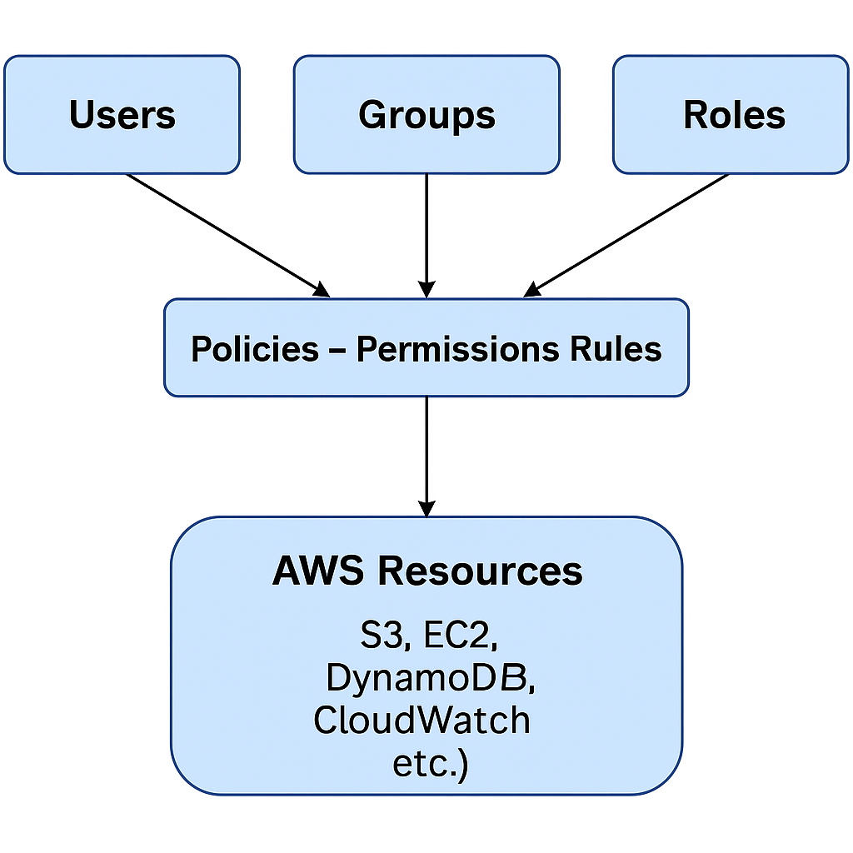
ARCHITECTURE

